Slide 1
flowcytoscript: A semi-automated high parameter flow cytometry workflow
Liston-Dooley Lab
Version 2, October 2023

Slide 2
simplified flowcytoscript at a glance
Features
Flow cytometry data analysis in R
User-friendly
programming knowledge not required
Interactive
Minimal input required
Optimized analysis parameters
Fast (~10x faster than prior version)
Html document record of the analysis
Any complicated stuff should be in FlowJo, not R.
Automated transformation—no more setting scales in FlowJo
Automated cluster identification
Choice of clustering algorithms
Output
tSNE and UMAP visualizations
Plotted with clusters
And with marker heatmaps
Clustering with Phenograph
Automated, no need to guess
Plots of cluster distribution
Table output for user to graph as well
Marker expression heatmaps
Marker expression histograms
Sample-level PCA on marker expression and cluster distribution
Plots of differing regions on tSNE/UMAP
2 samples only
Statistical analysis via Crossentropy test

Slide 3
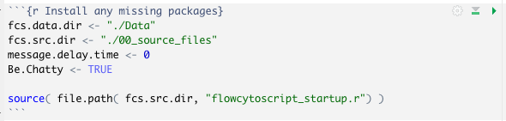


The entirety of the script, as seen by the user:

Slide 4
Using the simplified flowcytoscript
Install R, Rstudio and Rtools. For Mac, you’ll need command line tools and OpenMP.
Optional: run flowcytoscript_setup.r (in source_files) to help with this.
RStudio Desktop - Posit
https://cran.r-project.org/bin/windows/Rtools/
https://clanfear.github.io/CSSS508/docs/compiling.html
https://mac.r-project.org/openmp/
From your flow cytometry fcs files, gate on the cells you wish to analyze and export those cells in new fcs or csv files.
See instructions on the next slide.
Create a folder for your analysis (preferably not in Dropbox or OneDrive).
In this folder, put these items:
A copy of flowcytoscript.Rmd
A copy of source_files
Your files, inside a folder called “Data”
Double click on the flowcytoscript file to open it in Rstudio.
Run each code chunk in order by clicking on the green arrow in the upper right corner of the chunk.
The only tricky bit should be entering the names of your groups to locate the matching data files. This is currently done by exact text matching, so if your samples have file names like “WT_Brain”, you’ll need to type “WT_Brain” rather than “WT_brain”, WT Brain” or “wildtype brain”.

Slide 5
Exporting data from FlowJo
Set your gating strategy
Create groups (Ctrl+G) that represent the groups you wish to compare.
Add the appropriate samples to each group.
Apply the gating strategy to each group.
In each group, right-click on the population you wish to analyze (e.g., viable leukocytes, CD8 T cells).
Select “Export / Concatenate Group”
You should be working under the “Export” tab at the top. This will generate one new file for each of your current files, restricted to the population you’ve selected.
Under “Format”, select either “CSV – channel values” or “FCS”
Set “Destination” to be the “Data” folder for your flowcytoscript analysis.
Under “Parameters”, select “All compensated parameters”
Alternatively, select custom parameters and view/edit to choose.
Under “Include Events”, leave “Include All” selected
Expand “Advanced Options”
Under “File Naming”, delete “export”
In that field, type in the name of your group if it is not already a part of the file name.
Click “Export” in the lower right corner.

Slide 6
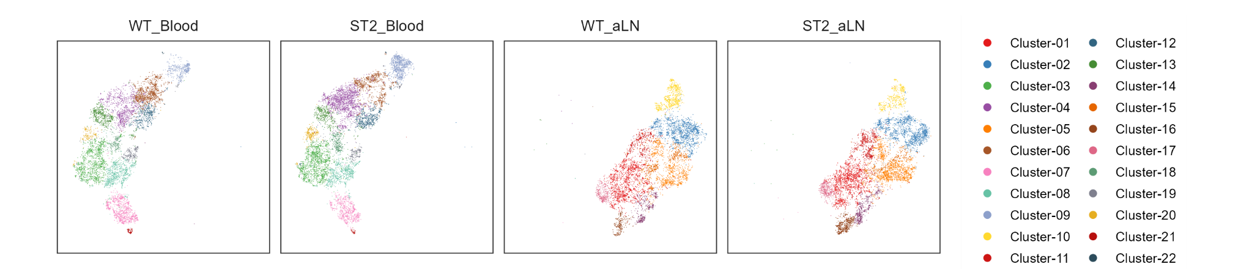
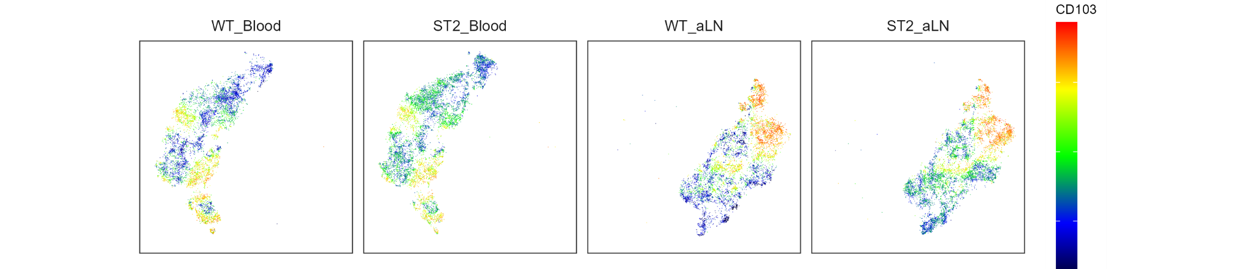
Example outputs: tSNE

Slide 7
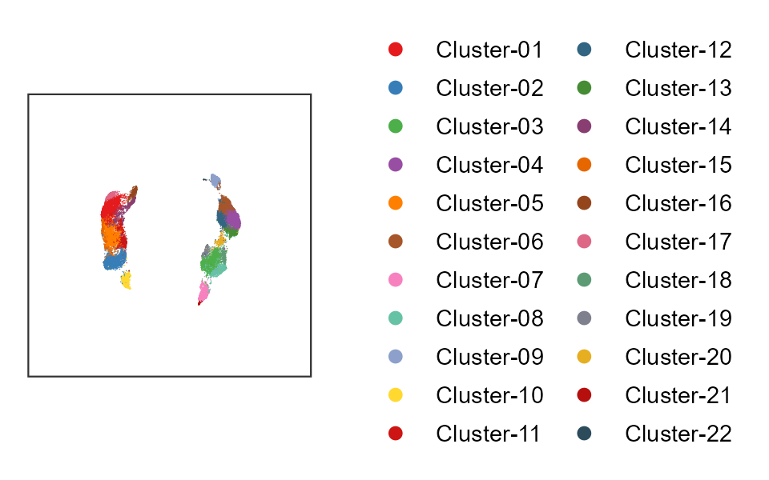
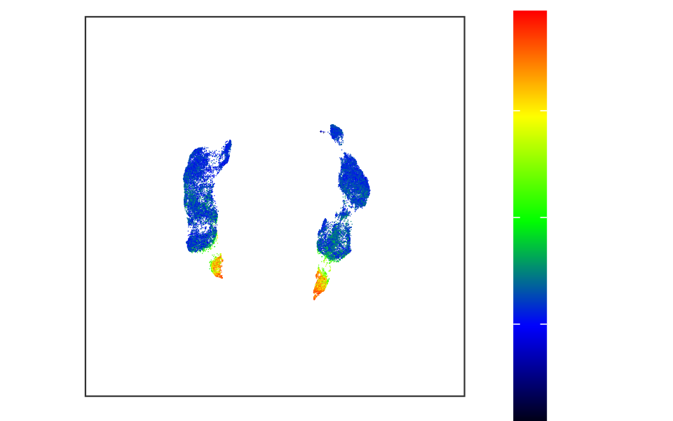
Example outputs: UMAP
KLRG1

Slide 8
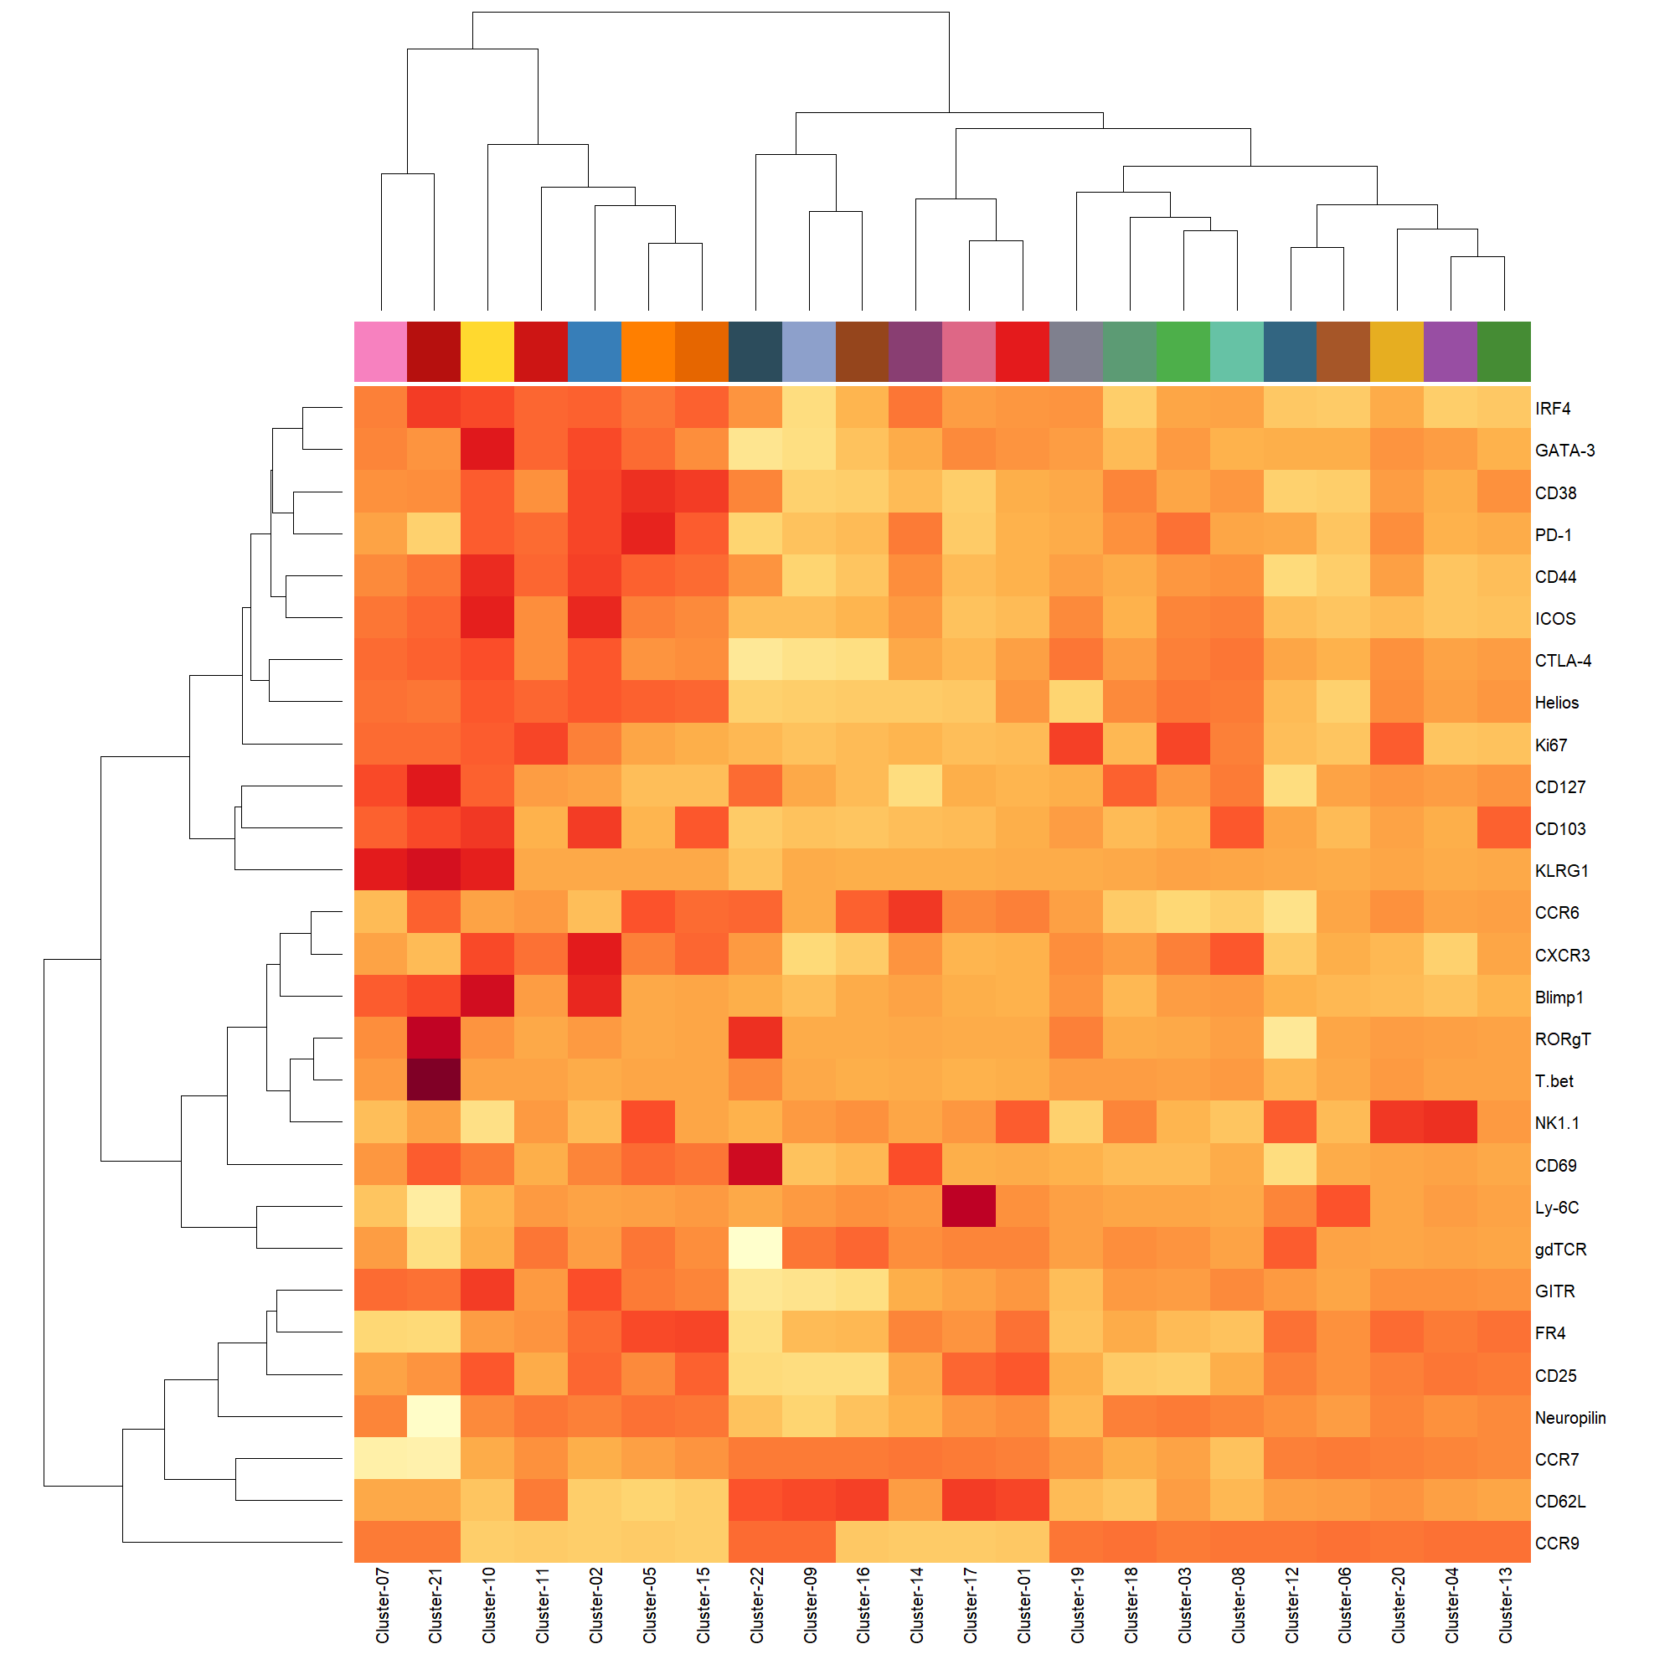
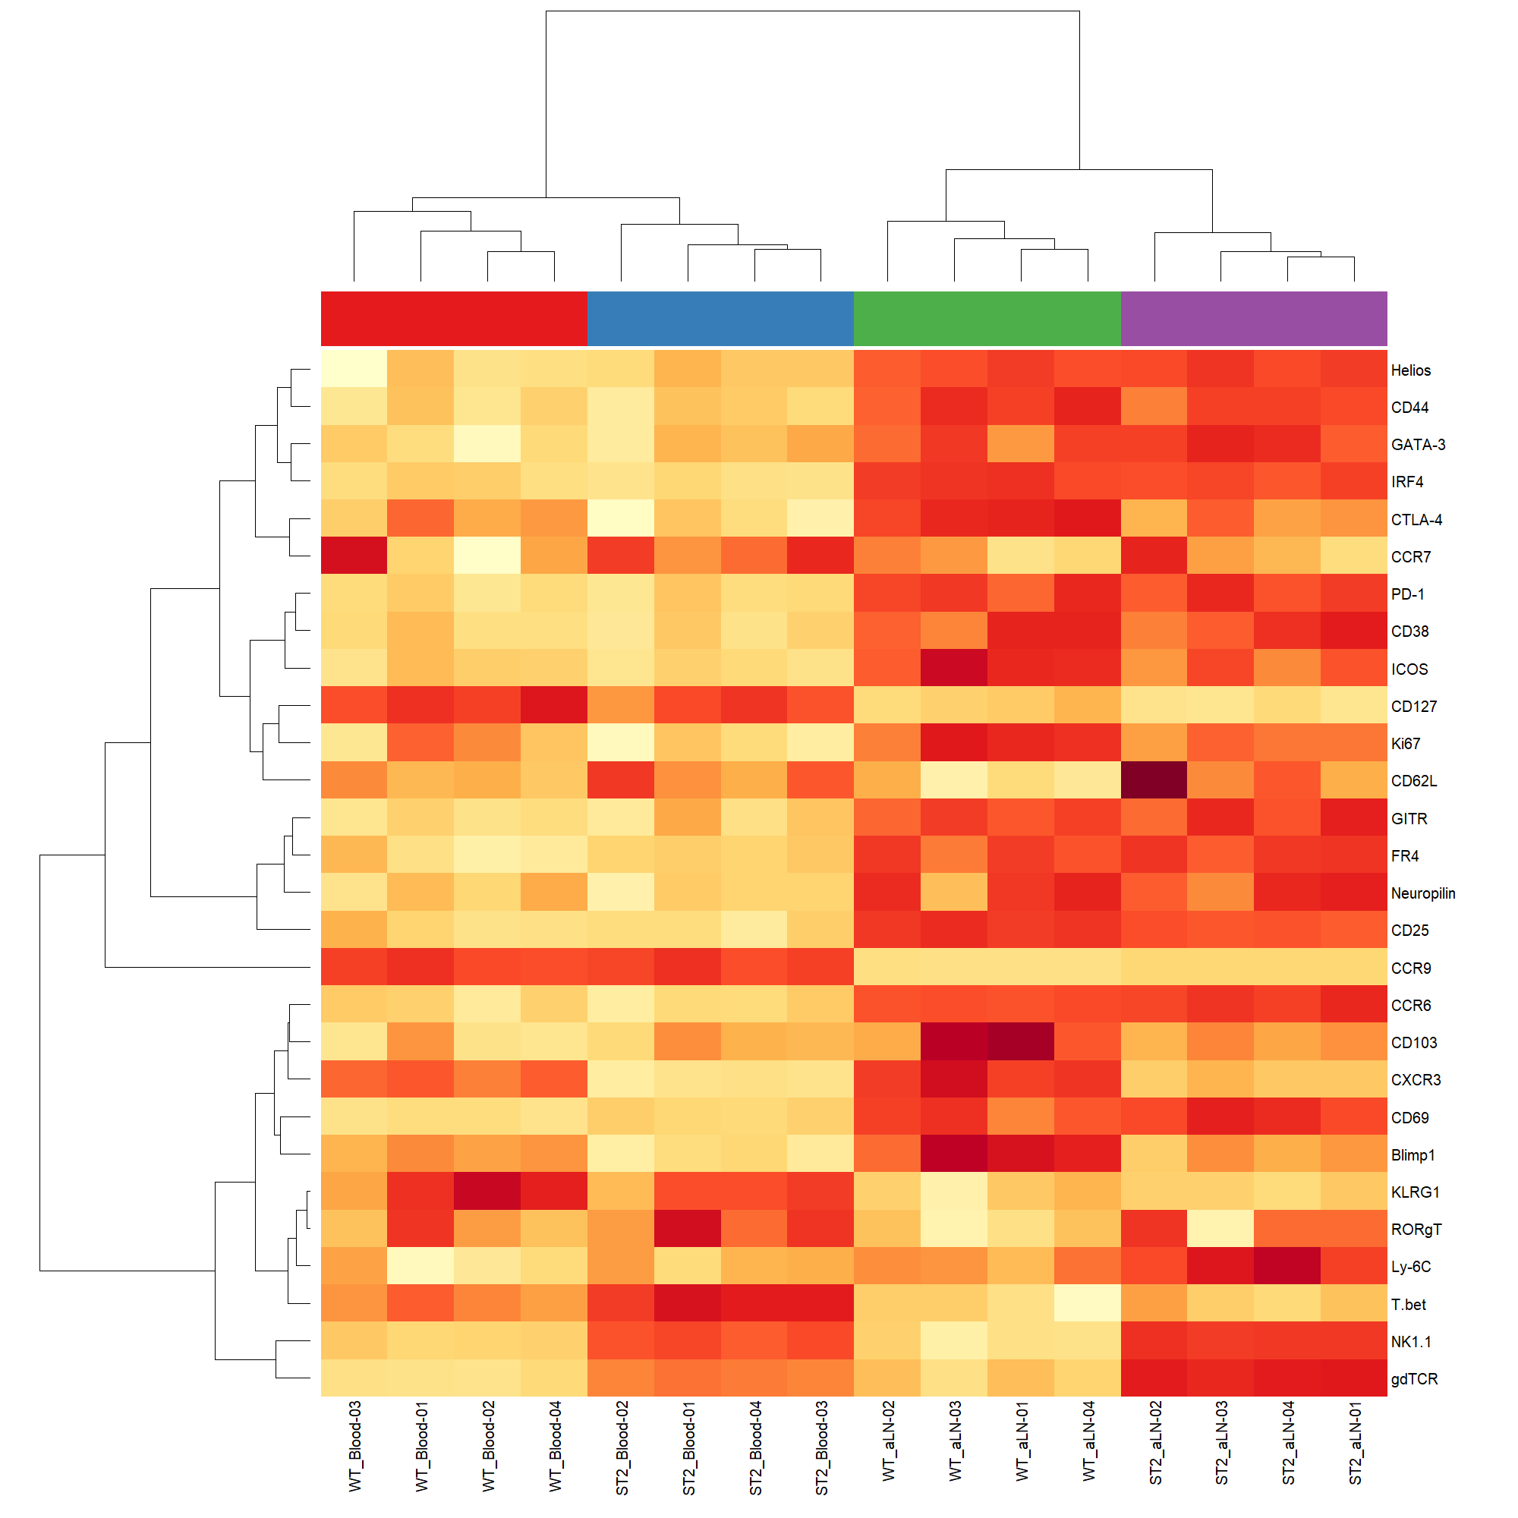
Example outputs: Heatmaps

Slide 9
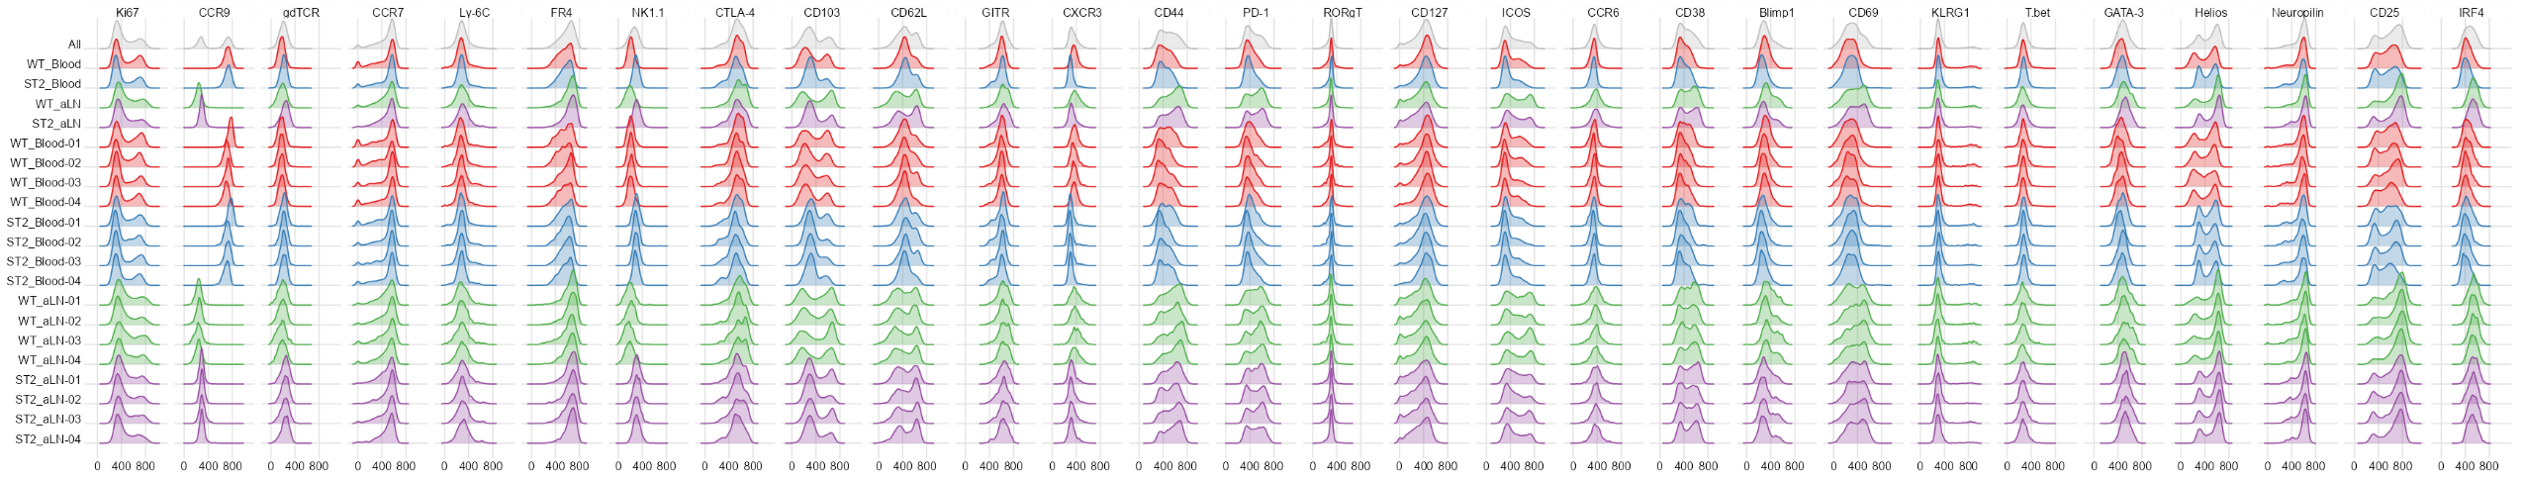
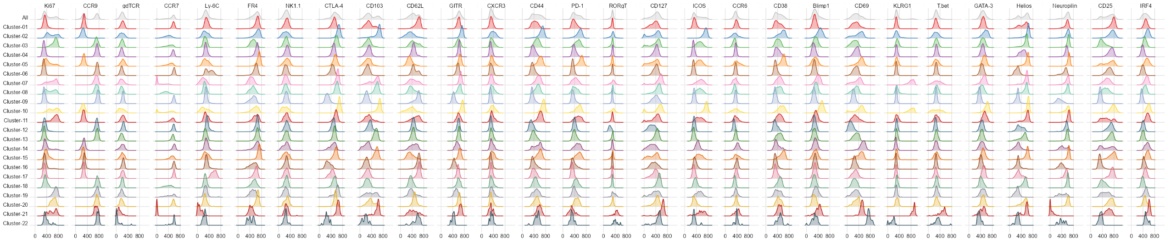
Example outputs: Marker density histograms

Slide 10
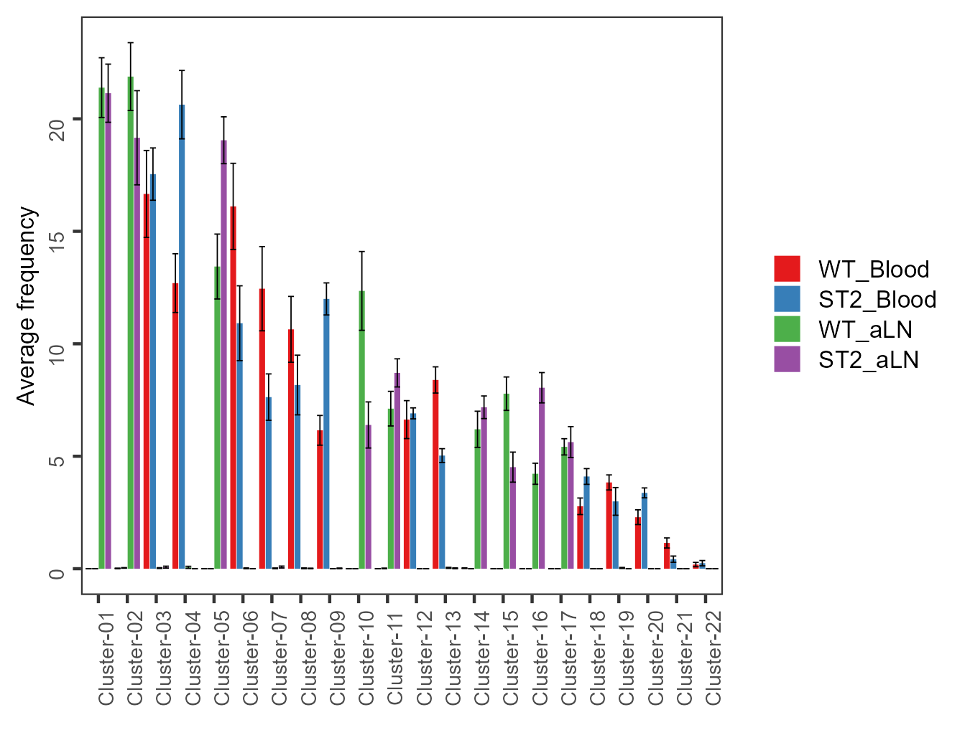
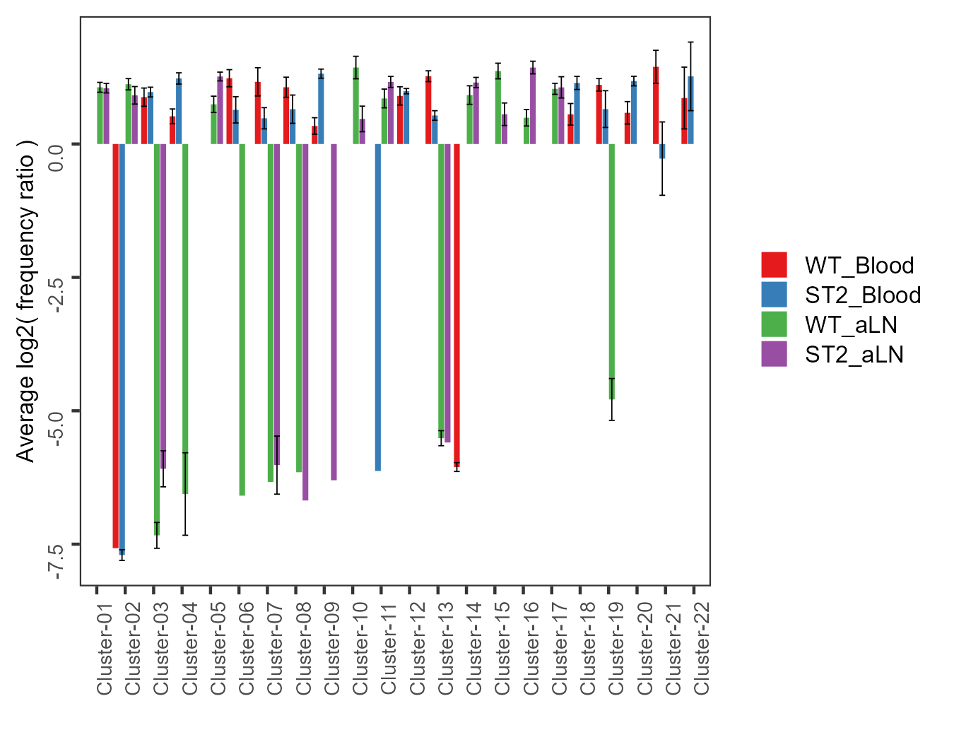
Example outputs: cluster histograms

Slide 11
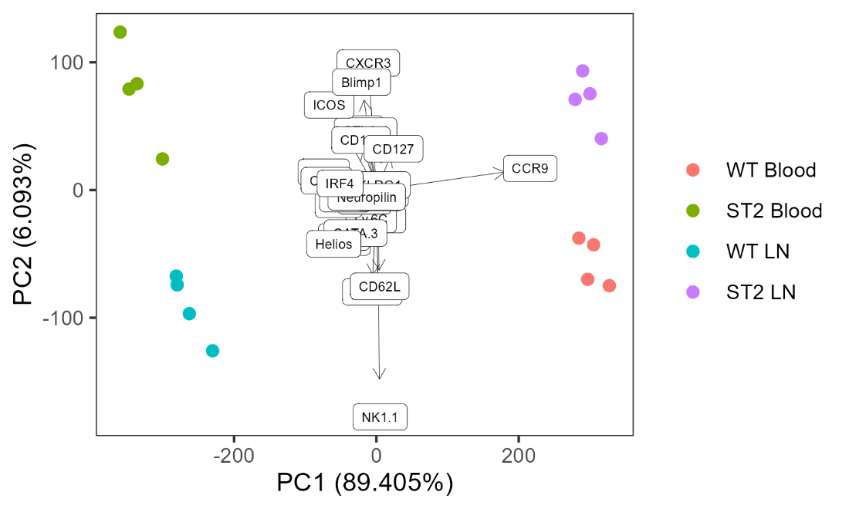
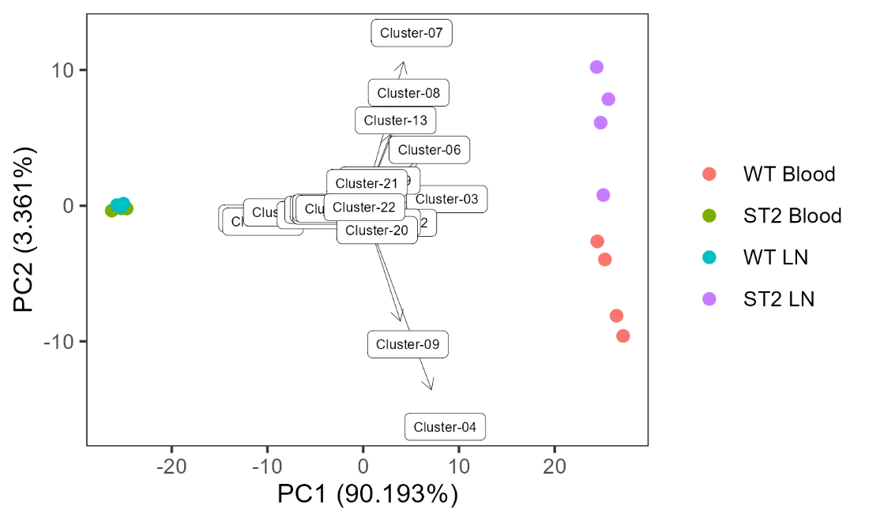
Example outputs: PCA plots

Slide 12
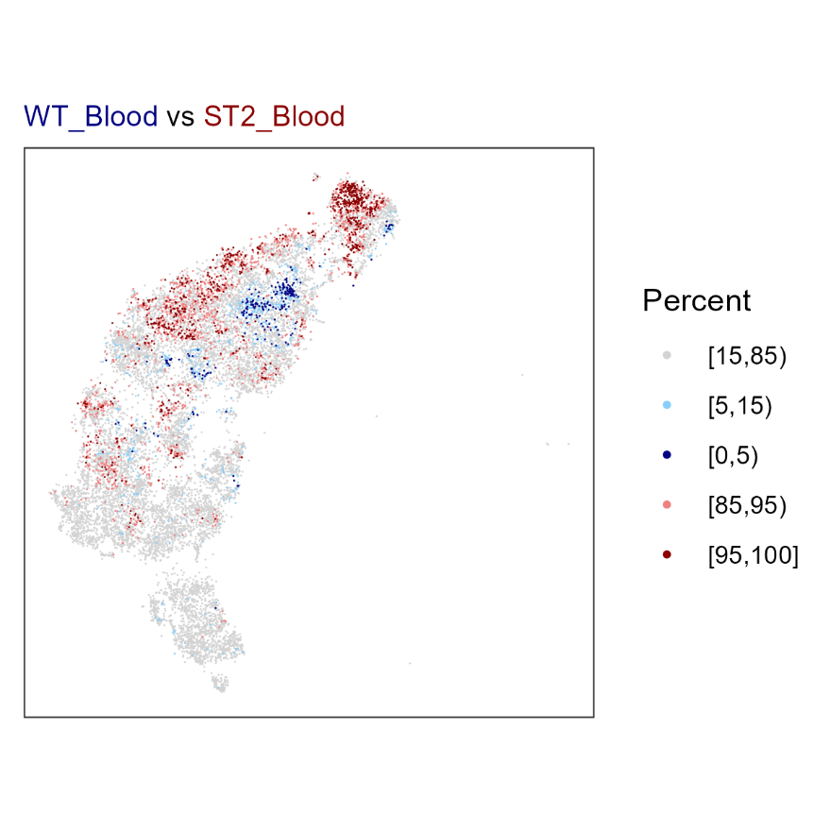
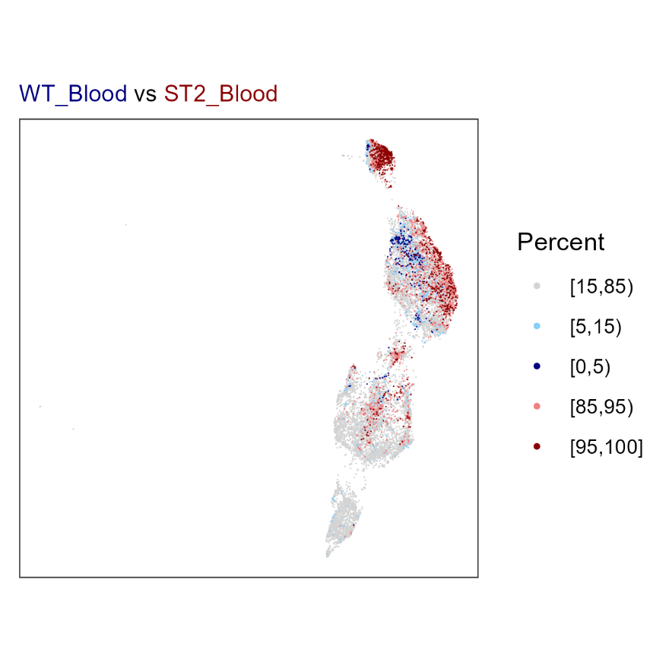
Example outputs: changed regions
tSNE plot
UMAP plot

Slide 13
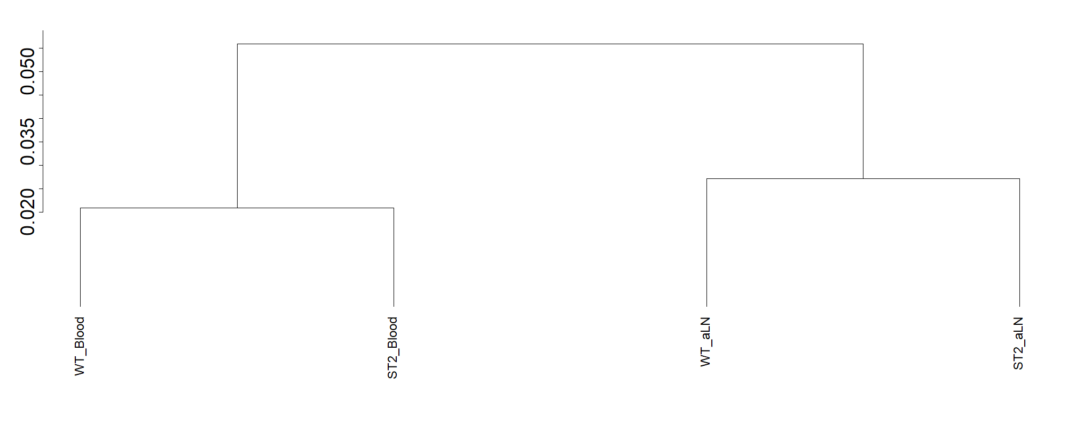
Example outputs: crossentropy testing
** Multiple Kolmogorov-Smirnov tests with Holm correction
WT_Blood - ST2_Blood D = 0.0210066 pv = 0.0811762 adj-pv = 0.0811762
WT_Blood - WT_aLN D = 0.0303903 pv = 0.00476673 adj-pv = 0.0143002
WT_Blood - ST2_aLN D = 0.0449463 pv = 1.44333e-06 adj-pv = 5.77333e-06
ST2_Blood - WT_aLN D = 0.0463281 pv = 5.99459e-07 adj-pv = 2.99729e-06
ST2_Blood - ST2_aLN D = 0.0558591 pv = 1.25355e-10 adj-pv = 7.52131e-10
WT_aLN - ST2_aLN D = 0.0272369 pv = 0.0133207 adj-pv = 0.0266414

